Slide 1
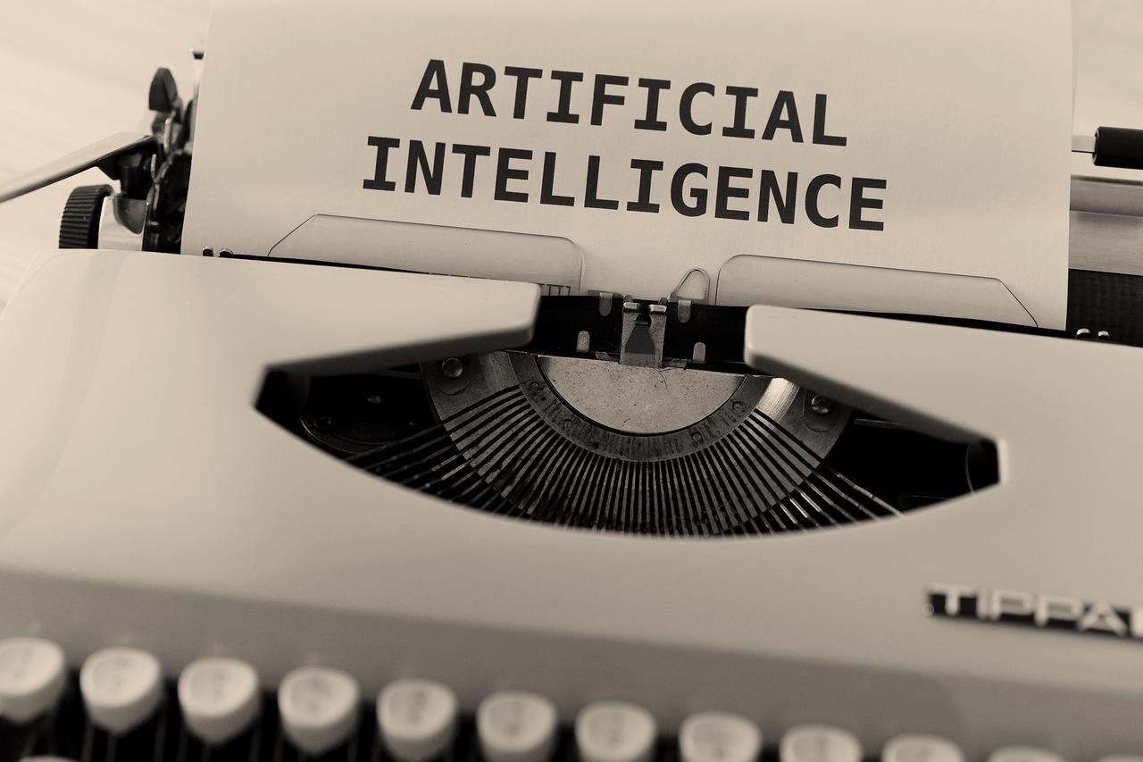
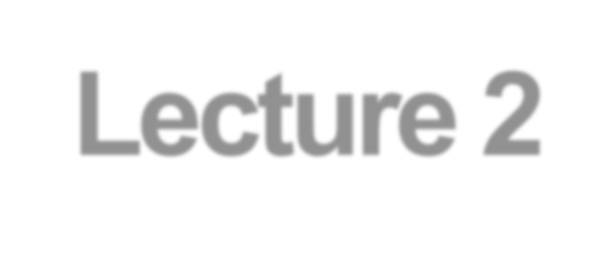


Artificial Intelligence
Software Engineering Programme
Lecture 2
Intelligent Agents, & AI Related Disciplines
2.1 Intelligent “Rational” Agents?
Recap: AI as the Study & Design of Intelligent Agents – Intelligent Agents in the World – Specifying the Task Environment [ PEAS ] – Goad-based vs. Cost-based Agents
2.2 Specifying the Task Environment
Environment Types
2.3 AI: Related Disciplines
Learning Agents – AI vs. Machine Learning vs. Deep Learning – Machine Learning? – Datamining? – AI vs. Data Science – Why Data Science? – Why Big Data?

Slide 2
Where are we now .. ?!
1: Course Introduction & Plan
2: An introduction to Artificial Intelligence [AI] 3: Intelligent Agents, & AI Related Disciplines
4: Solving Problems by Searching, and State Space Search Strategies & Structures 5: Knowledge Representation via Propositional & Predicate Calculi
6: Problem Solving as Search (Blind / Uninformed vs. Heuristic / Informed Strategies) 7: Problem Solving as Search (More on Heuristic Search + Adversarial Search)
8: Beyond Classical Search (Evolutionary / Genetic Algorithms)
9: Heuristic Optimization, Hill Climbing, Gradient Descent, & Simulated Annealing
10: Supervised Machine Learning: Decision Trees via the ID3 Algorithm + Business Intelligence app. via Weka 11: The Learning Problem, the Perceptron, & the Perceptron Learning Algorithm [PLA]
12: Multilayer Perceptron [MLP], & an introduction to Artificial Neural Networks [ANNs]
13: Loss Functions, Weights Optimization, & Support Vector Machines [SVMs]
Course & Lectures are based on their counterparts in the following:
Intelligent Systems, University of British Columbia (Dept. of CS)
Introduction to Artificial Intelligence, University of Wisconsin-Madison
Artificial Intelligence, University of Illinois at Urbana-Champaign
Artificial Intelligence, University of California, Berkeley
S. Russell & P. Norvig, "Artificial Intelligence: A Modern Approach," 3rd Ed.
G. Luger, "Artificial Intelligence: Structures & Strategies for Complex Problem Solving," 5th Ed.
W. Ertel, "Introduction to Artificial Intelligence," 2nd Ed.

Slide 3
Lecture 2: Intelligent Agents, & AI Related Disciplines
2.1 Intelligent “Rational” Agents?
Recap: AI as the Study & Design of
Intelligent Agents
Intelligent Agents in the World
An Example: Vacuum_Agent
Specifying the Task Environment [ PEAS ]
Goad-based vs. Cost-based Agents
2.2 Specifying the Task Environment
Environment Types
2.3 AI: Related Disciplines
Learning Agents
AI vs. Machine Learning vs. Deep Learning
Machine Learning?
Datamining?
AI vs. Data Science
Why Data Science?
Why Big Data?

Slide 4
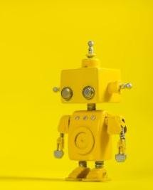
Acting Rationally
Intelligent Agents
4

Slide 5


MainResources forthisSection
This lecture covers mainly the following chapter(s):
Chapter 2 (Intelligent Agents) from Stuart J. Russell and Peter Norvig, "Artificial Intelligence: A Modern Approach," Third Edition (2010), by Pearson Education Inc.
5

Slide 6
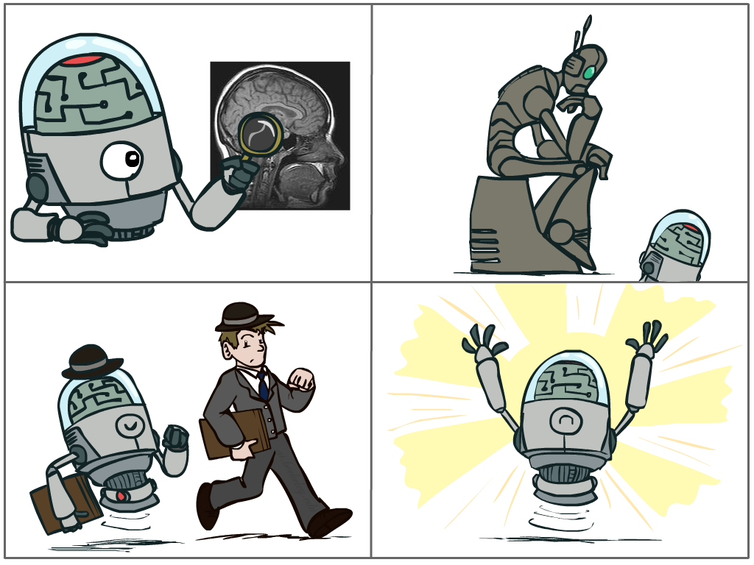
What is Artificial Inteligence?
Recap ..
Four Main Approaches that have been followed, each by different
people with different methods.
the Cognitive
Modelling approach
Thinking Humanly
the Turing Test
approach
Acting Humanly
Thinking Rationally
Acting Rationally
the Rational Agent
a p p roach
t h e Laws-of-Thought approach
6

Slide 7

Recap ..
So .. It al started as .. Systems that Act Like Humans ..
7

Slide 8
Recap ..
What is Artificial Inteligence?
Systems that act like humans | Systems that think rationally
“The study of how to make computers do things at which, at the moment, people are better” (Rich and Knight, 1991) “The art of creating machines that perform functions that require intelligence when performed by people.” (Kurzweil, 1990) | “The study of mental faculties through the use of computational models” (Charniack and McDermott, 1985). “The study of the computations that make it possible to perceive, reason, and act.” (Winston, 1992)
Systems that think like humans | Systems that act rationally
“The automation of activities that we associate with human thinking, such as decision making, problem solving, learning” (Bellman, 1978) “The exciting new effort to make computers think … machines with minds, in the full and literal sense.” (Haugeland, 1985) | “AI .. is concerned with intelligent behavior in artifacts (Nilsson, 1998) “Computational Intelligence is the study of the design of intelligent agents.” (Poole et al., 1998)
8

Slide 9
AI as the Study & Design of Intelligent Agents
Recap ..
(Poole and Mackworth, 1999)
An intelligent agent is such that:
Its actions are appropriate for its goals and circumstances.
It is flexible to changing environments and goals.
It learns from experience.
It makes appropriate choices given perceptual limitations and
limited resources (bounded rationality or bounded optimality).
This definition drops the constraint of cognitive plausibility;
Same as building flying machines by understanding general principles of flying (aerodynamic) vs. by reproducing how birds fly.
Thus, a rational agent acts to optimally achieve its goals (does the right thing). The right thing: that which is expected to maximize goal achievement, given the available information.
9

Slide 10
Recap ..
Intelligent Agents
In AI, artificial agents that have a physical presence in the world are usually known as Robots.
Robotics is the field primarily concerned with the implementation of the physical aspects of a robot (i.e. perception of the physical environment, actions on the environment).
Another class of artificial agents include interface agents, for either stand alone or Web-based applications (e.g. intelligent desktop assistants, recommender systems, intelligent tutoring systems).
Interface agents don’t have to worry about interaction with the physical environment, but share all other fundamental components of intelligent behavior with robots.
We will focus on these agents in this course (i.e. software agents not hardware agents “autonomous robots”).
10

Slide 11
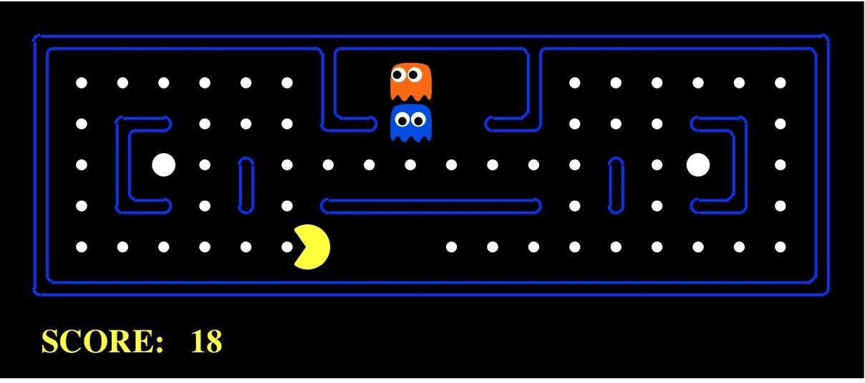
Pac-Man .. as an ..Intelligent Agent
Recap ..
Agent
Sensors
?
Actuators
Percepts
Environment
Actions
11

Slide 12

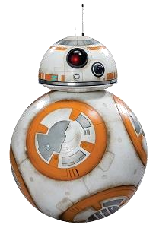
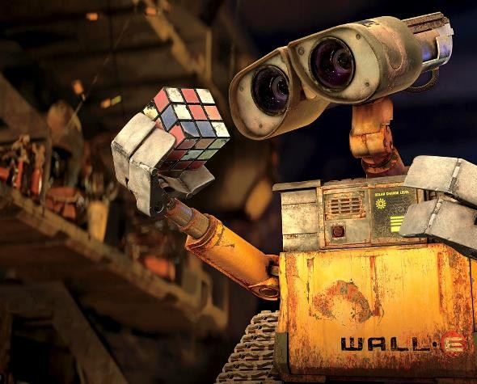
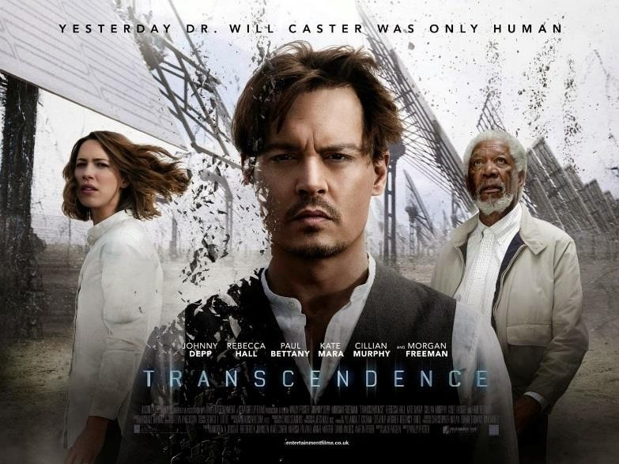
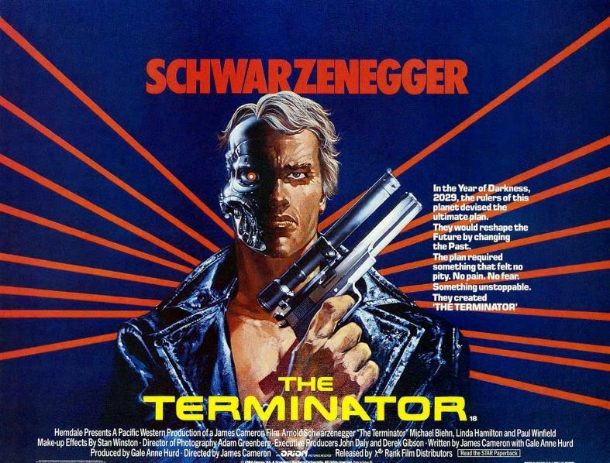

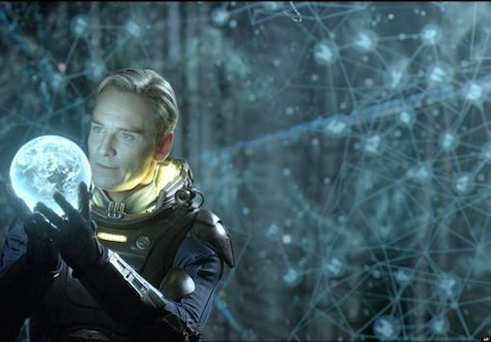

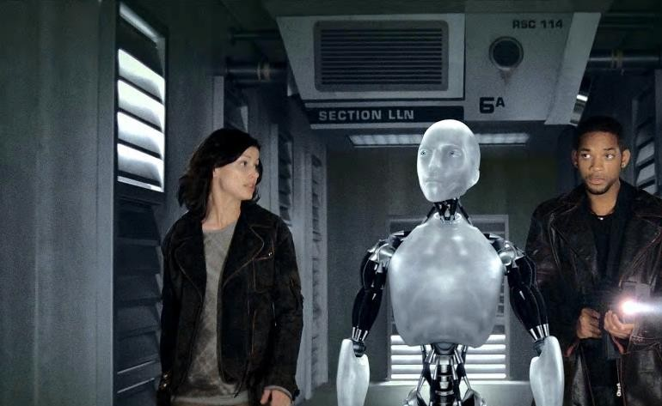
BB-8 “the Star Wars franchise”
Intelligent “Rational” Agents?
Agent Smith in The Matrix (1999)
Dr. Will Caster
Arthur, an android bartender on the Avalon, Passengers
David in Prometheus (2012)
Sonny in I, Robot (2004)

Slide 13
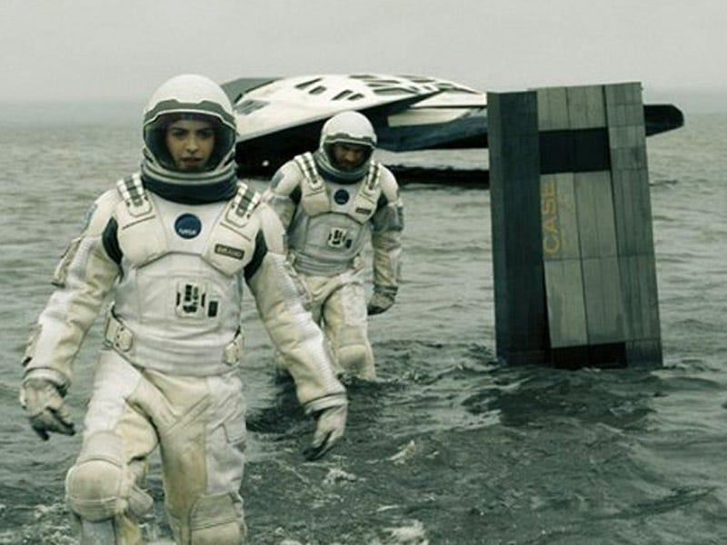

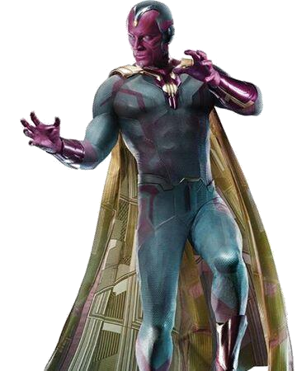
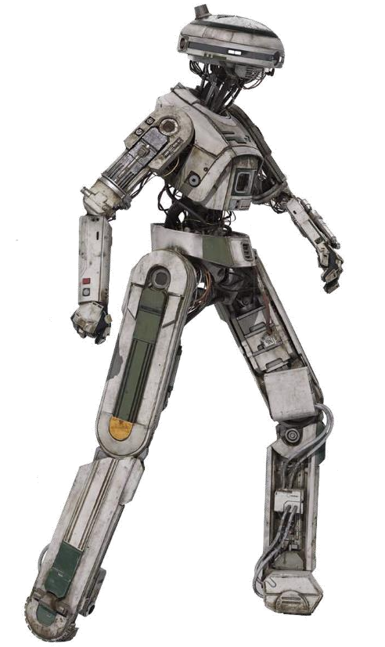
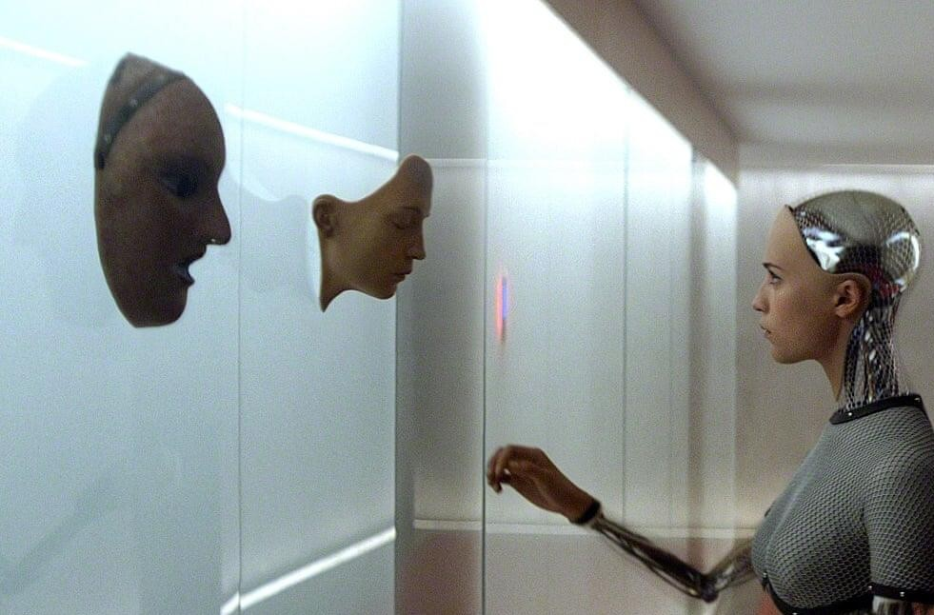
Intelligent “Rational” Agents? !
Automata
TARS and CASE
Interstellar
L3 (Star Wars –
Han Solo)
Vision (Marvel Comics)
Ava,
in Ex Machina

Slide 14
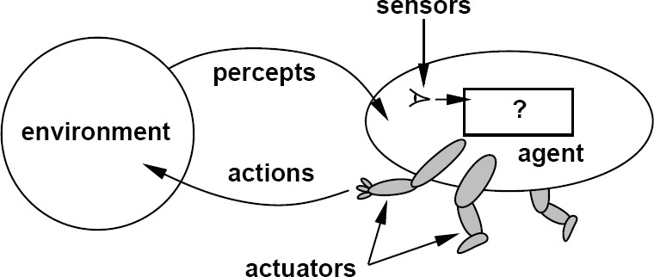



Intelligent Agents
An agent is anything that can be viewed as perceiving its environment through sensors and acting upon that environment through actuators.

Slide 15
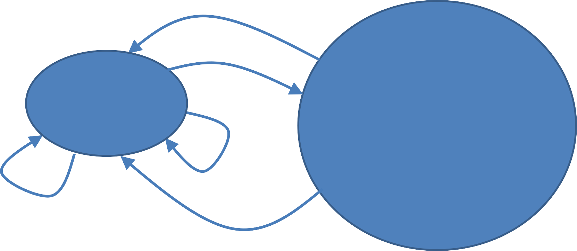
IntelligentAgents in the World ..
.. Learning? .. Feedback?
1: Sense
3: Act
AI
“Agent”
Environment
2: Reason
5: Learn
4: Get Feedback

Slide 16
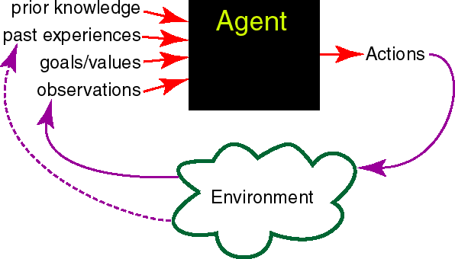
IntelligentAgents in the World ..
Knowledge Representation Machine Learning
.. Capacities / Fields?
Reasoning + Decision Theory
Natural Language Generation
+
Robotics
+
Human Computer
/Robot Interaction
Natural Language Understanding
+
Computer Vision Speech Recognition
+
Physiological Sensing
Mining of Interaction Logs
16

Slide 17
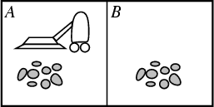

Example: Vacuum –Agent
Percepts:
Location and status,
e.g., [A, Dirty]
Actions:
Left, Right, Suck, NoOp
function Vacuum_Agent( [ location, status ] ) returns an action
if status = Dirty then return Suck else if location = A then return Right else if location = B then return Left

Slide 18


Rational Agents
For each possible percept sequence, a rational agent should select an action that is expected to maximize its performance measure, given the evidence provided by the percept sequence and the agent’s built-in knowledge.
Performance measure (utility function):
An objective criterion for success of an agent's behaviour.

Slide 19







Specifying the Task Environment [ PEAS ]
PEAS: Performance measure, Environment, Actuators, Sensors
P: a function the agent is maximizing (or minimizing); Assumed given ..
In practice, needs to be computed somewhere.
E: a formal representation for world states;
For concreteness, a tuple (var₁ = val₁, var₂ = val₂, … , var_{n} = val_{n}).
A: actions that change the state according to a transition model; Given a state and action, what is the successor state (or distribution over successor states)?
S: observations that allow the agent to infer the world state; Often come in very different form than the state itself ..
E.g., in tracking, observations may be pixels and state variables
3D coordinates.

Slide 20

PEAS Example 1: Autonomous Taxi
Performance measure
Safe, fast, legal, comfortable trip, maximize profits
Environment
Roads, other traffic, pedestrians, customers
Actuators
Steering wheel, accelerator, brake, signal, horn
Sensors
Cameras, LIDAR, speedometer, GPS, odometer, engine sensors, keyboard

Slide 21


PEAS Example 2: Spam Filter
Performance measure
Minimizing false positives, false negatives
Environment
A user’s email account, email server
Actuators
Mark as spam, delete, etc.
Sensors
Incoming messages, other information about user’s account

Slide 22
Goal-based Agents versus Cost-based Agents
Goal-based agents: the actions depend on the goal; E.g., a mobile robot which should move from room 112 to room 179 in a building takes actions different from those of a robot that should move to room 105.

Slide 23
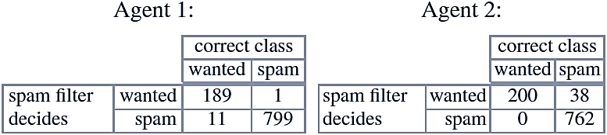
Goal-based Agents versus Cost-based Agents
Cost-based agents: the goal is to minimize the cost of erroneous decisions in the long term; E.g., a spam filter is an agent that puts incoming emails into wanted or unwanted (spam) categories & deletes any unwanted emails. Its goal as a goal- based agent is to put all emails in the right category. In the course of this not-so- simple task, the agent can occasionally make mistakes. Because its goal is to classify all emails correctly, it will attempt to make as few errors as possible. However, that is not always what the user has in mind. Let us compare the following two agents. Out of 1,000 emails, Agent 1 makes only 12 errors. Agent 2 on the other hand makes 38 errors with the same 1,000 emails. Is it therefore worse than Agent 1? The errors of both agents are shown in more detail in the following confusion matrix:
Agent 1 in fact makes fewer errors than Agent 2, but those few errors are severe because the user loses 11 potentially important emails. Because there are in this case two types of errors of differing severity, each error should be weighted with
the appropriate cost factor.

